Slide 1


ZeroZero.pt
HUMAN-COMPUTER INTERACTION
ASSIGNMENT 1 - P3
05/03/2024
Alexandre Martins (103552) LECI
Bruno Gomes (103320) LECI
João Gonçalves (98287) mecT

Slide 2

What is zerozero?
Football news
Statistics about different teams, players, and competitions
Live scores of the matches
Targeted at football lovers

Slide 3

WHY DID WE CHOOSE “ZEROZERO”
Absurd amount of information;
Confusing navigation;
Cluttered layout;
Inconsistent design elements.

Slide 4
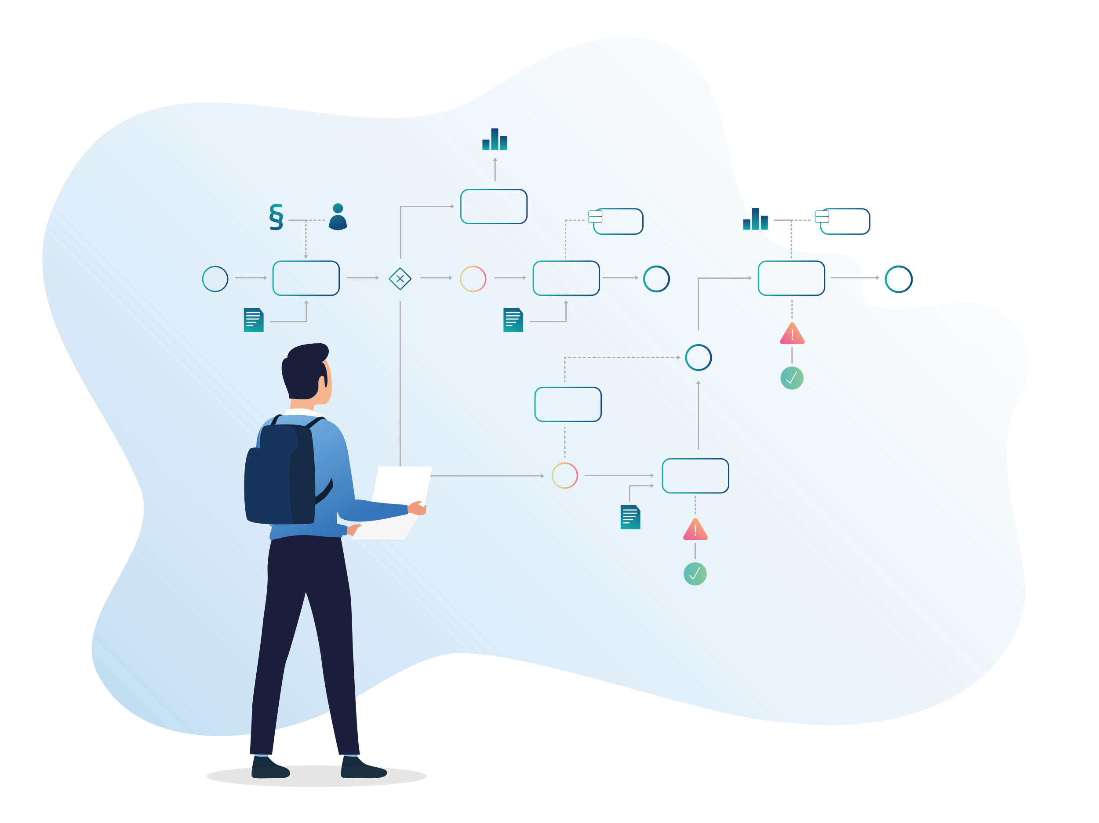
The process
Analytical methods to evaluate the usability of the system.
Find problems: 10 Usability Heuristics for User Interface Design.
Rate: Severity Ratings for Usability Problems.
Cognitive walkthroughs: Streamlined Cognitive Walkthrough.

Slide 5
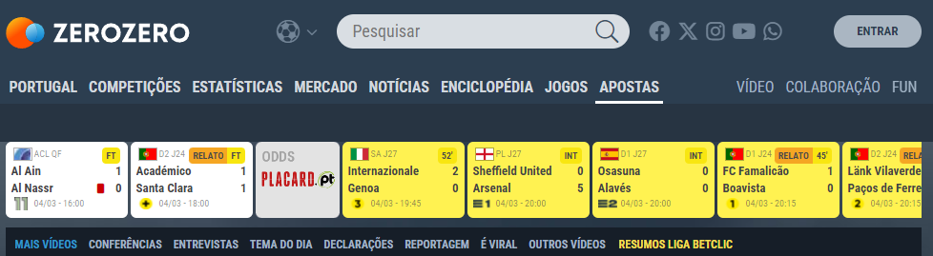

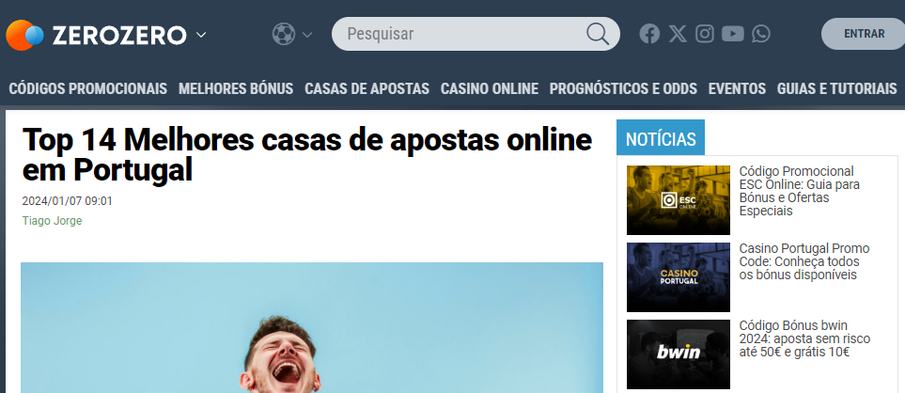
heuristic
3 – User Control and Freedom
Why?
After entering "APOSTAS" a new page opens and we can't get back to the home page.
Severity: 3 - Major usability problem

Slide 6
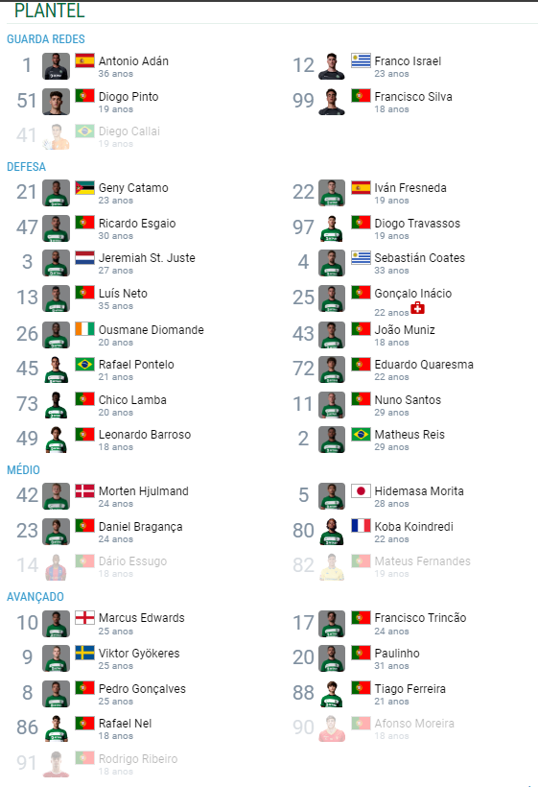
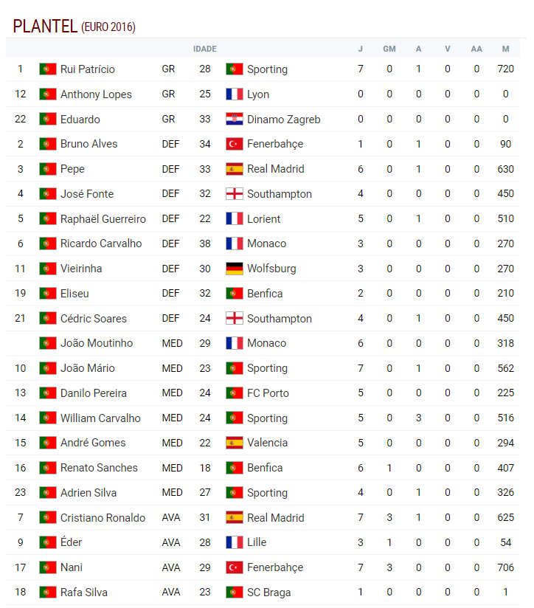
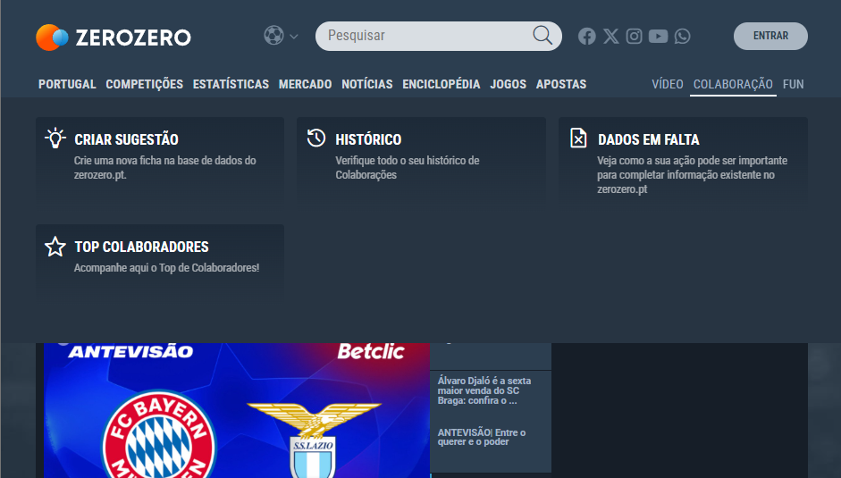
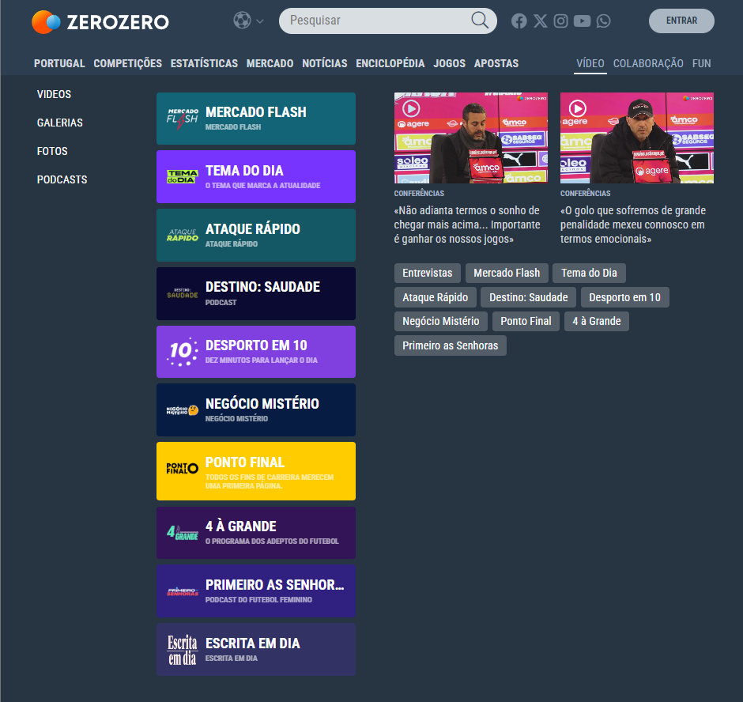
heuristic
4 – Consistency and Standards
Why?
Website doesn’t follow a set of fixed rules;
The lack of consistency, makes the website unpredictable;
Severity: 2 - Minor usability problem

Slide 7
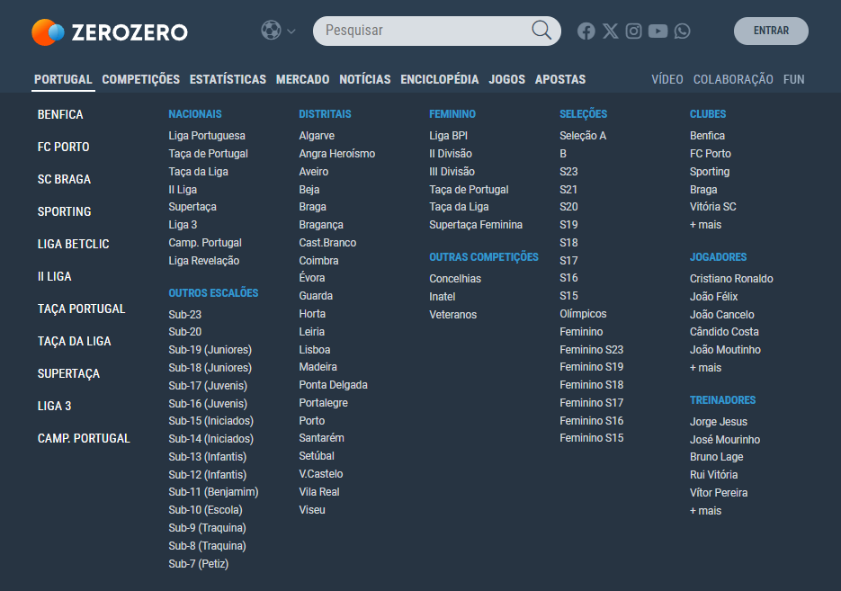
heuristic
6 - Recognition Rather than Recall
Why?
Information isn’t easily retrievable
User will need to memorize the structure of the interface to navigate properly
They way information is displayed isn’t intuitive for the user
Severity: 2 - Minor usability problem

Slide 8
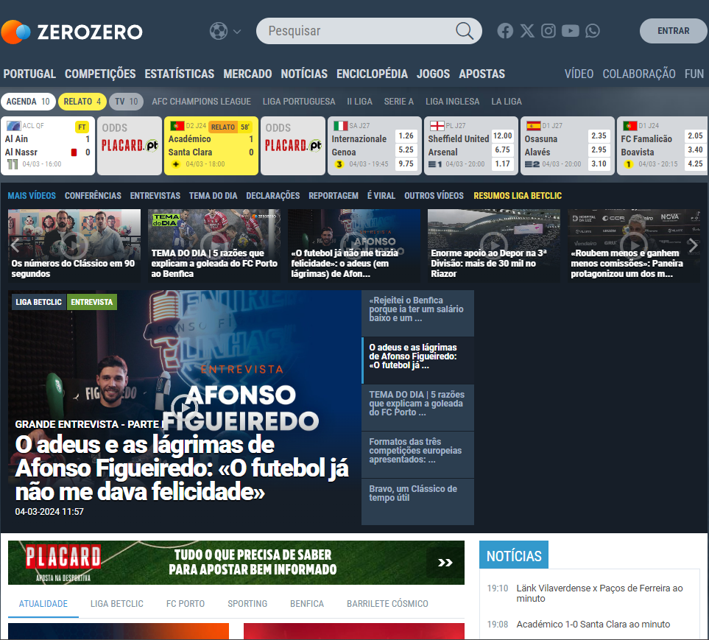
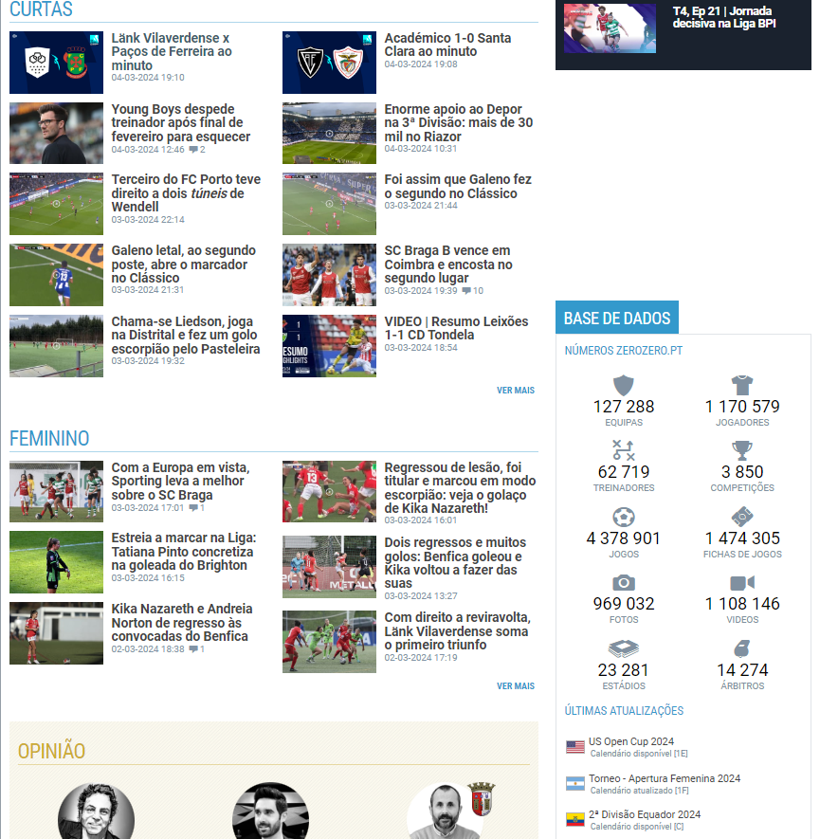
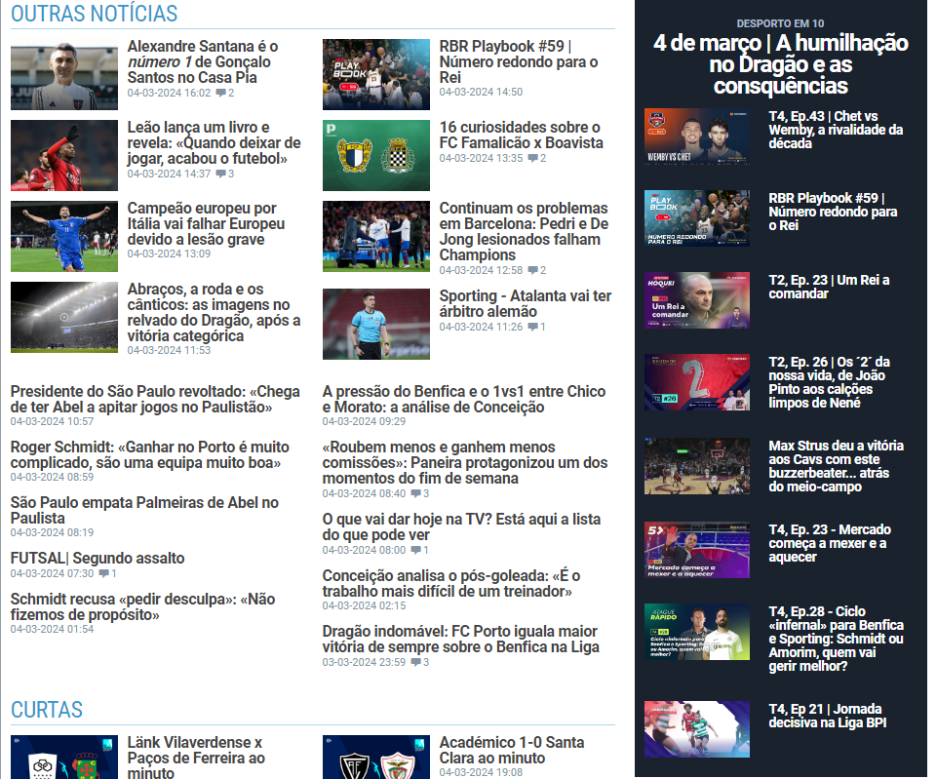
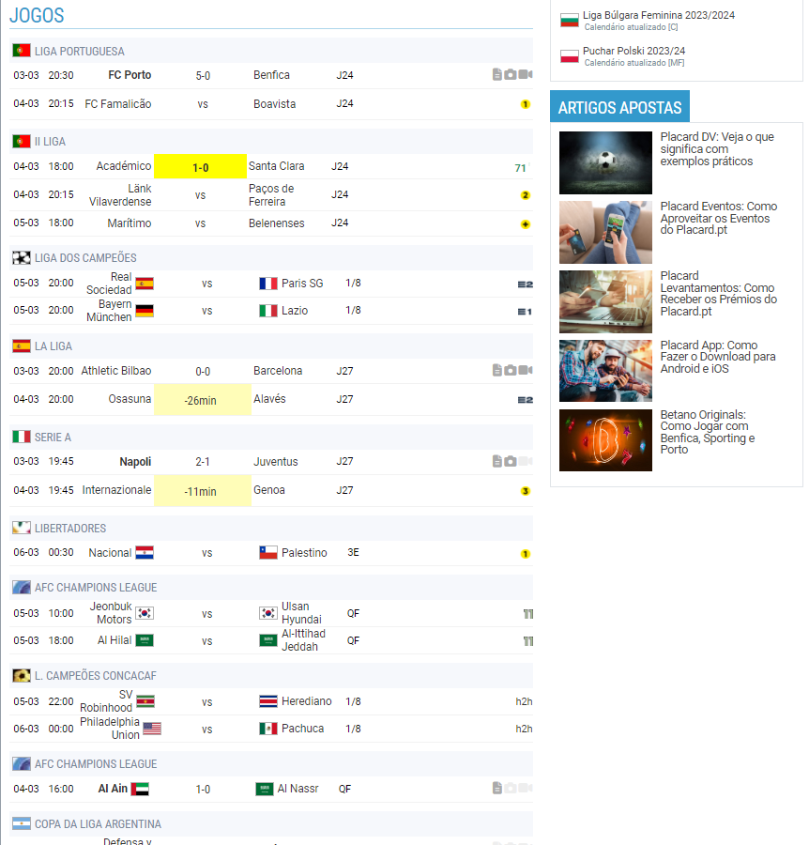
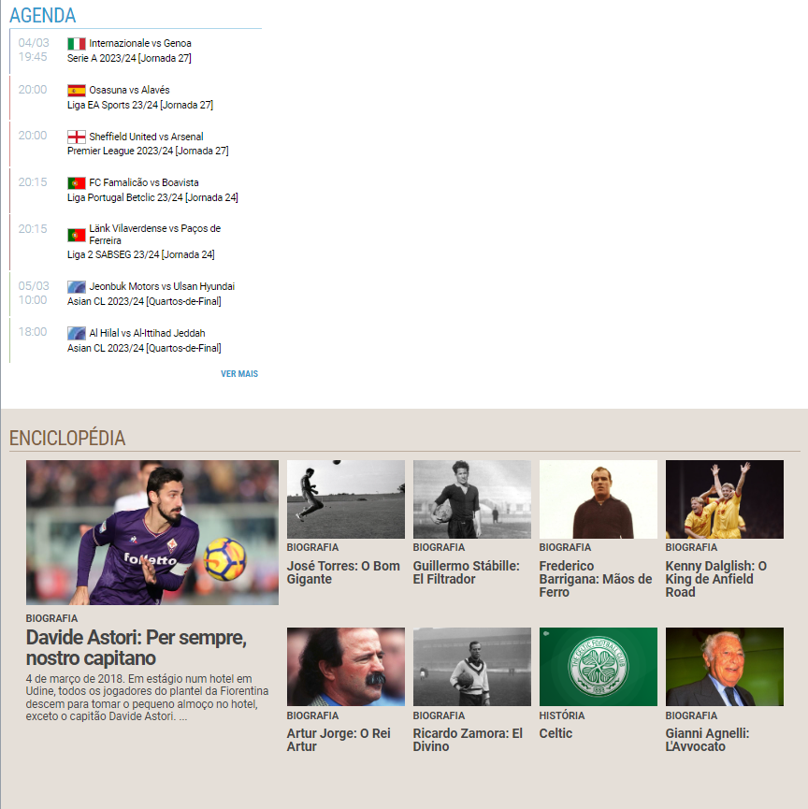
heuristic
7 - Flexibility and Efficiency of Use
Why?
Navigation is complicated
Endless Scrolling
Severity: 3 - Major usability problem

Slide 9
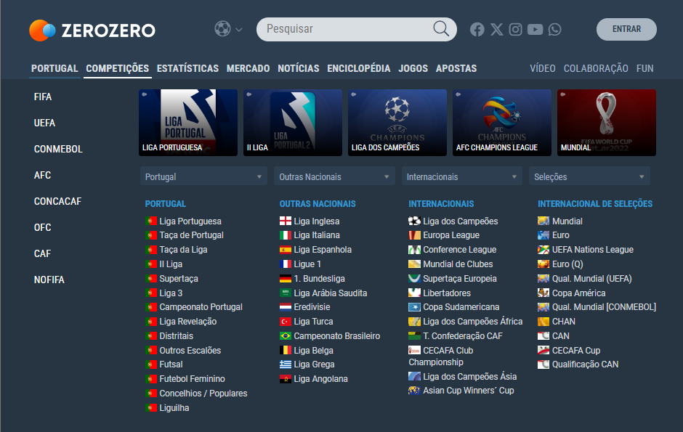
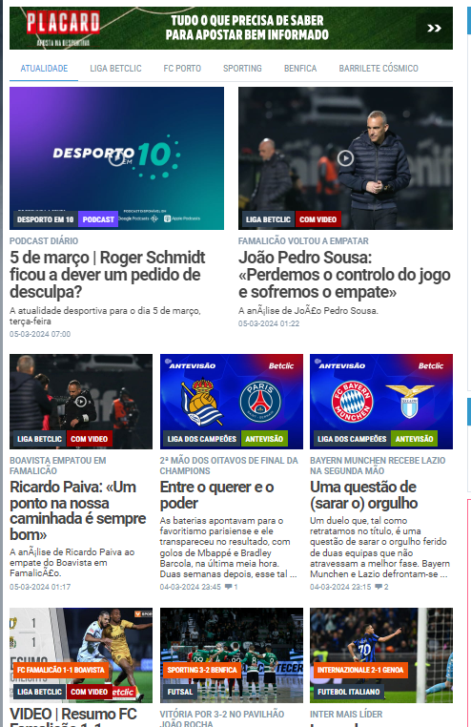
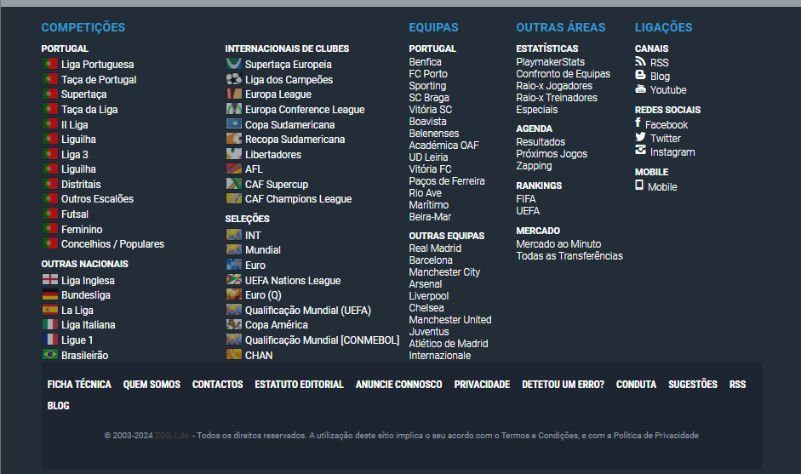
heuristic
8 - Aesthetic and Minimalist Design
Why?
Overwhelming information and redundancy throughout the site;
Repetition of information;
Design resembling a newspaper adds to the cluttered interface rather than achieving a minimalist look.
Severity: 3 - Major usability problem

Slide 10
Severity table
 | Alexandre Martins | Bruno Gomes | João Gonçalves | Median
User Control and Freedom | 3 | 3 | 3 | 3
Consistency and Standards | 3 | 2 | 2 | 2.33
Recognition Rather than Recall | 2 | 3 | 2 | 2.33
Flexibility and Efficiency of Use | 3 | 3 | 3 | 3
Aesthetic and Minimalist Design | 3 | 2 | 3 | 2.66

Slide 11

Cognitive walkthrough
Let’s consider a simple task, where a young football fan wants to check the Portugal squad that won the European Championship of 2016;
The user is used to access information quickly and expects an intuitive interface;
This user never visited this website;
For each step of this task, two questions should be considered:
Q1: will the user know what to do at this step? Q2: if the user does the right thing, will they know that they did the right thing, and are making progress towards their goal?

Slide 12
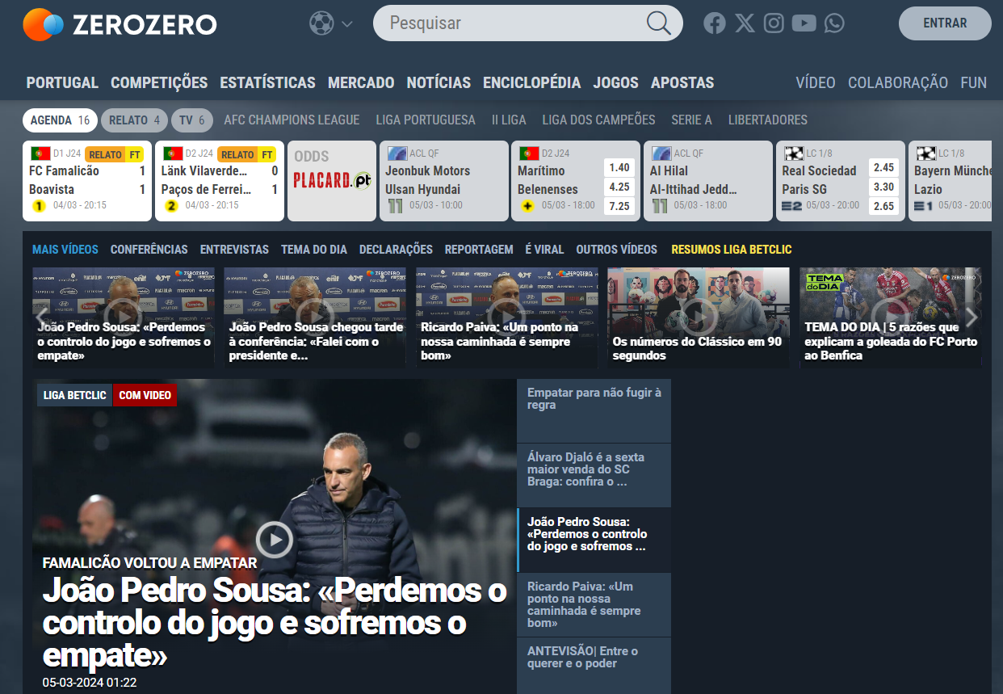
First step – find out where to go
A1: Maybe, with plenty of information, the user should search the desired result by trial and error;
A2: Yes, only if the user finds the competitions tab;

Slide 13
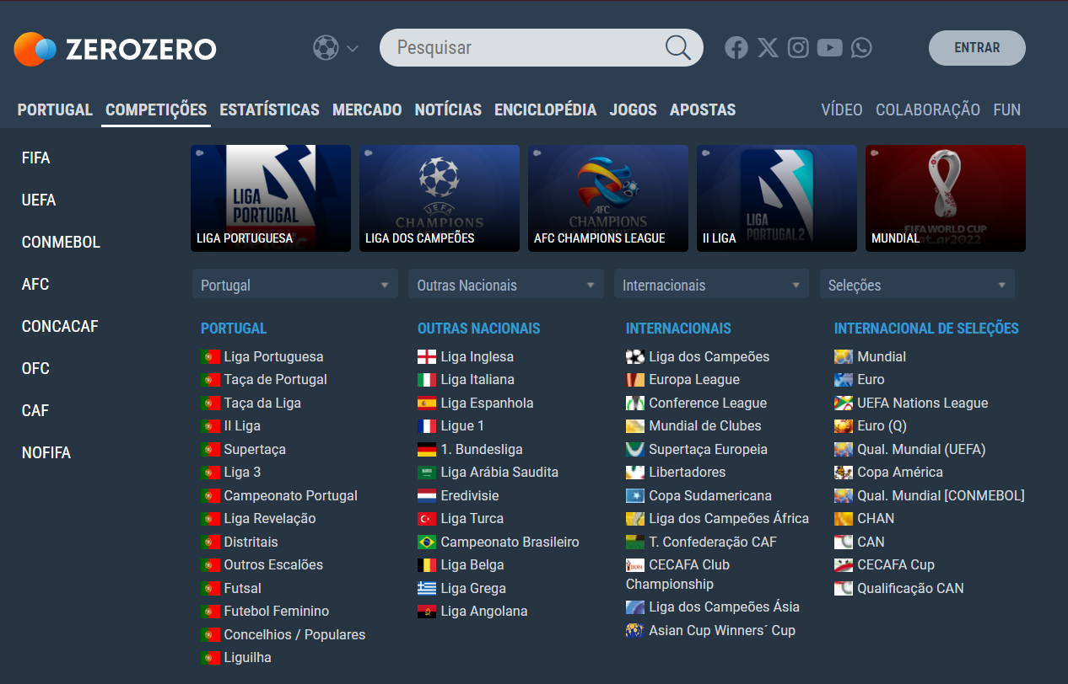
Second step – Choose the competiton
A1: Yes, the user will only have to choose the desired competition;
A2: Yes, because the user will be presented with the details of the most recent European Championship;

Slide 14
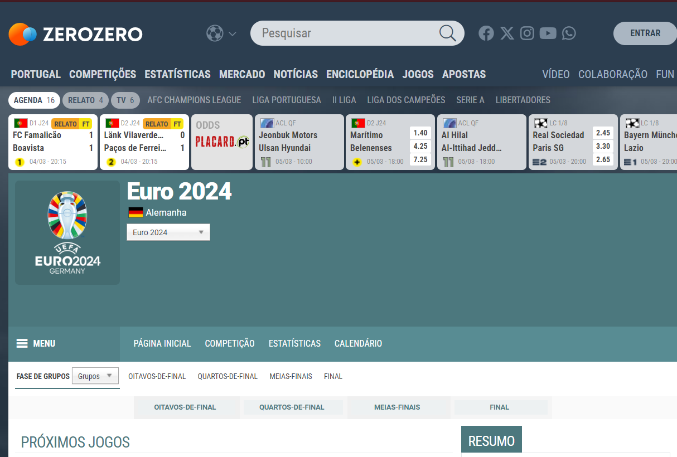
THIRD-STEP – choose THE COMPETITION YEAR
A1: Yes, this step is obvious, the user gets presented with a dropdown to choose the year of the competition;
A2: Yes, the user will have access to various statistic about a certain edition of the competition;

Slide 15
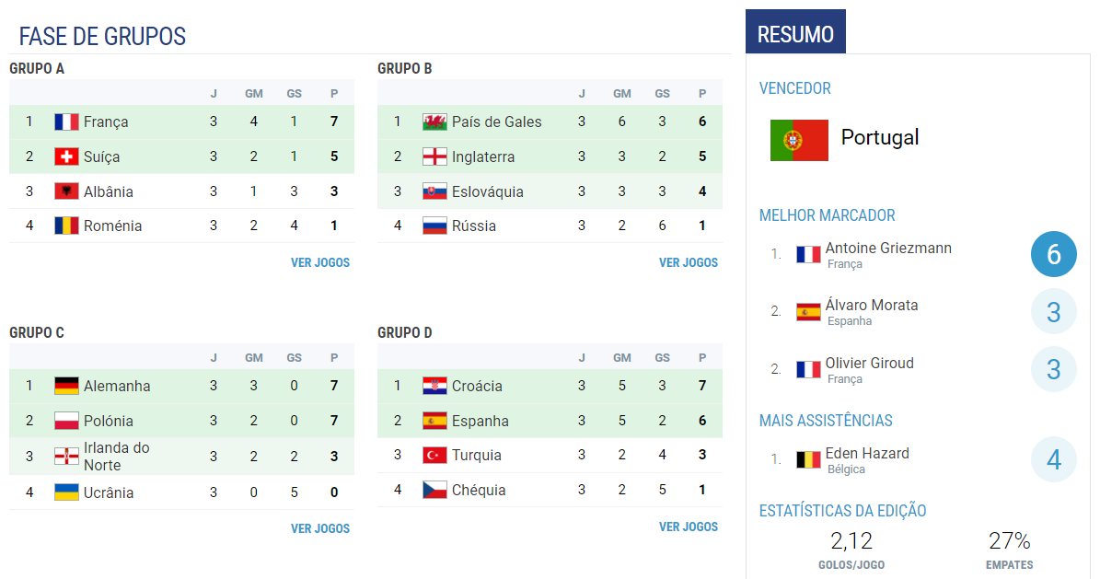
Fourth step – Find Portugal
A1: No, this part is not intuitive, the user will have to search thorougly to see the squad;
A2: Maybe, the user will have to scroll down some more to see the desired results;

Slide 16
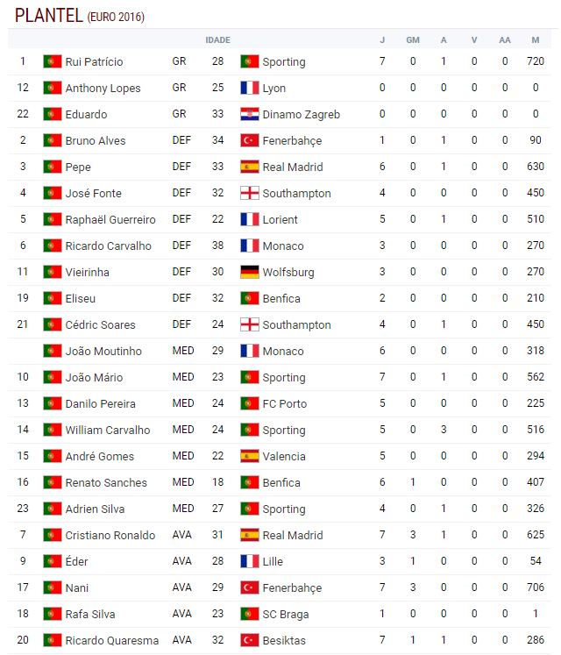
FIFTH STEP – check the squad
A1: Yes, this part is obvious, the user gets to see the players names;
A2: Yes, here the user will definitely know he did the right thing even though there should be images of the faces of each player;

Slide 17
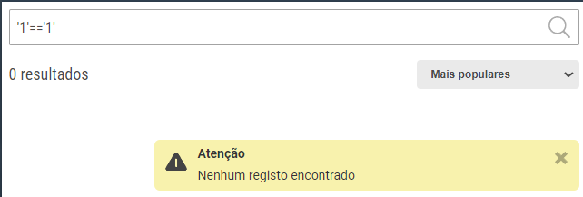
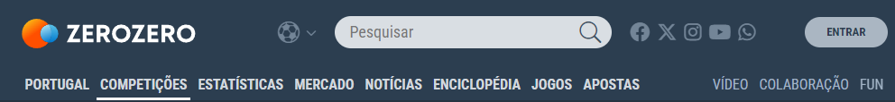
Positive aspects
Good search bar;
Intuitive navbar;
Error Prevention;
Pop-up buttons are used;

